Slide 1
Machine learning
Regent College London
SWE6204

Slide 2
Machine learning
SWE6204

Slide 3

Machine learning
OVERVIEW OF DEEP NEURAL NETWORK

Slide 4
Module 1 – OVERVIEW OF DEEP NEURAL NETWORK

Slide 5
Learning objectives
Introduction to Deep Neural Network (DNN)
Understand ML performance
Understand Overfitting
Tuning your DNN Topology
Introduction to CNN

Slide 6
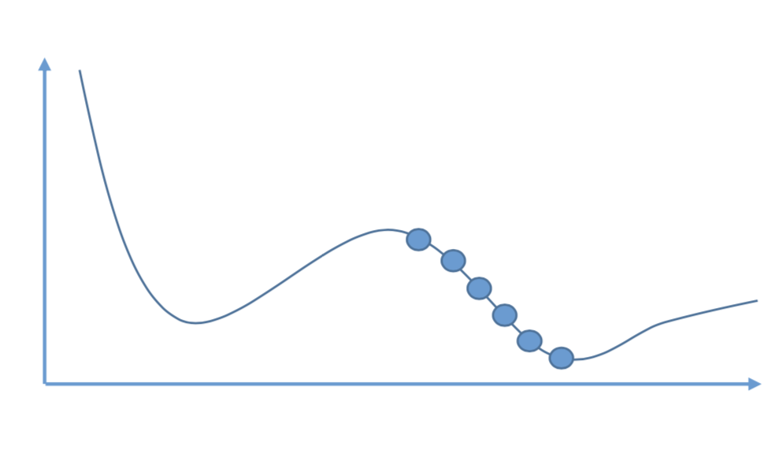
Learning objectives
How do you train a MLP’s weights? How does it learn?
Backpropagation... or more specifically: Gradient Descent using reverse-mode autodiff!
For each training step:
Compute the output error
Compute how much each neuron in the previous hidden layer contributed
Back-propagate that error in a reverse pass
Tweak weights to reduce the error using gradient descent

Slide 7
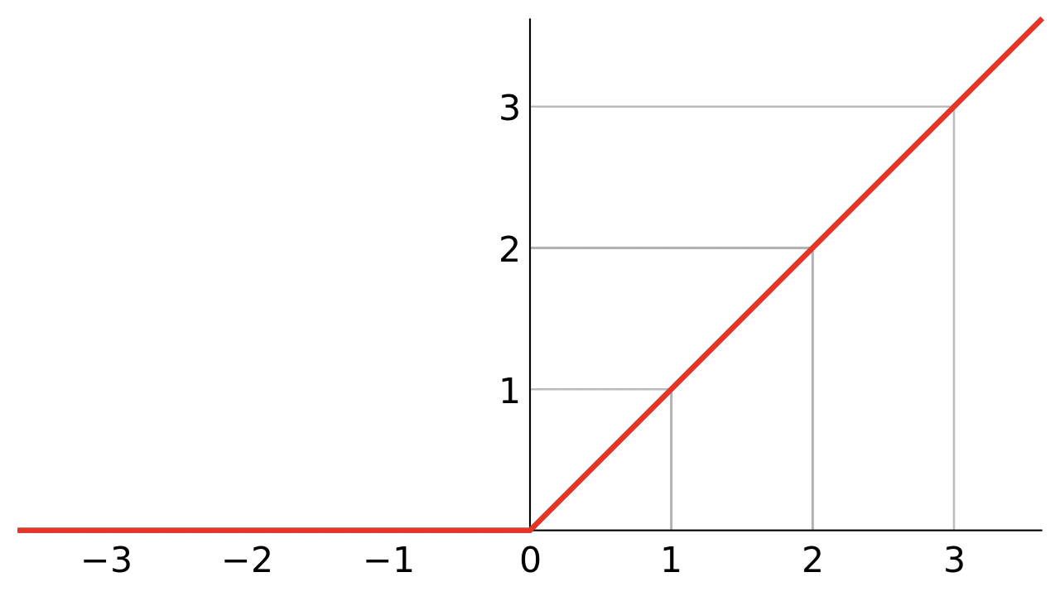
Activation function (AKA filter)
Step functions don’t work with gradient descent – there is no gradient!
Mathematically, they have no useful derivative.
Alternatives:
• Logistic function
• Hyperbolic tangent function
• Exponential linear unit (ELU)
• ReLU function (Rectified Linear Unit)
ReLU is common. Fast to compute and works well.
• Also: “Leaky ReLU”, “Noisy ReLU”
• ELU can sometimes lead to faster learning though.

Slide 8
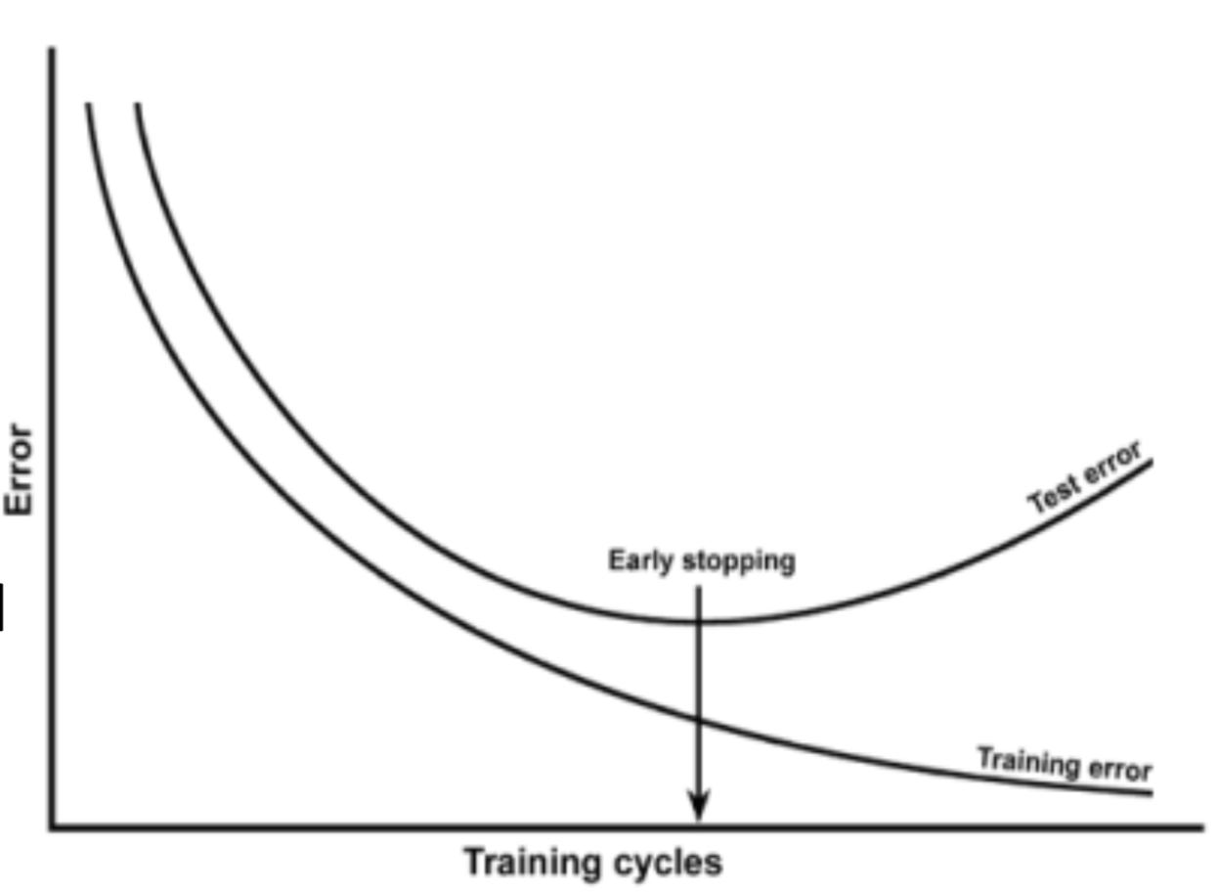
ML Performance
Method used to train a ML algorithm
  – Sample the training set
  – Choose parameters to reduce the training set error
  – Sample the test set
Then it is proved that the expected
training error ≤ expected test error
Conclusion:
  – Make the training error small
  – Make the gap between training and test error small

Slide 9
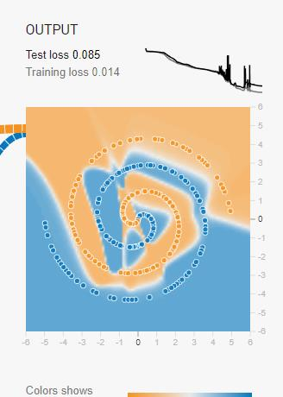
Avoid overfitting
With thousands of weights to tune, overfitting is a problem
Early stopping (when performance starts dropping)
Regularization terms added to cost function during training
Dropout – ignore say 50% of all neurons randomly at each training step
- Works surprisingly well!
- Forces your model to spread out its learning

Slide 10
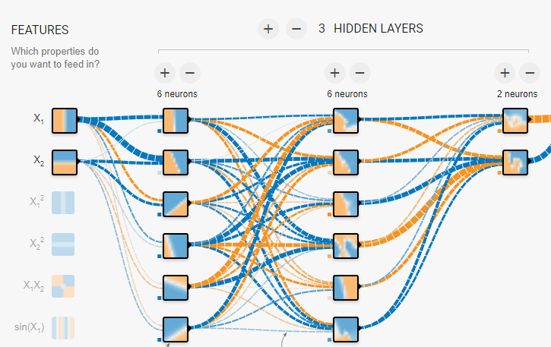
Learning objectives
Trial & error is one way
- Evaluate a smaller network with less neurons in the hidden layers
- Evaluate a larger network with more layers
- Try reducing the size of each layer as you progress – form a funnel
More layers can yield faster learning
Or just use more layers and neurons than you need, and don’t care because you use early stopping.

Slide 11
DNN Simulator Activity
Browse the Simulator below
https://playground.tensorflow.org/#activation=tanh&batchSize=10&dataset=circle&regDataset=reg-plane&learningRate=0.03&regularizationRate=0&noise=0&networkShape=4,2&seed=0.30956&showTestData=false&discretize=false&percTrainData=50&x=true&y=true&xTimesY=fal
Find the best DNN to classify the Spiral data set.

Slide 12
Learning objectives

Slide 13
Learning objectives

Slide 14
Learning objectives

Slide 15
+44 (0)207 016 8000
info@rcl.ac.uk

